Slide 1
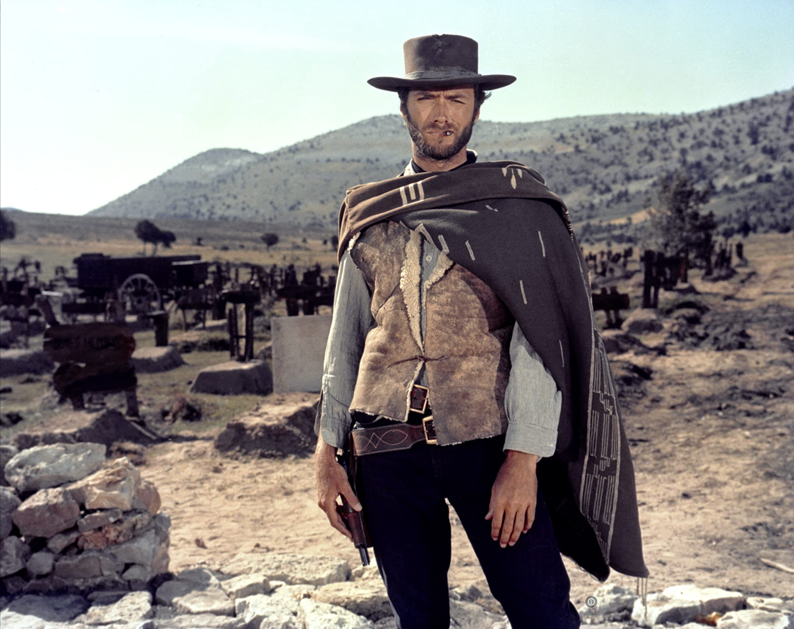

The Easy, the Hard and the Ugly
Easy
Inference (fit)
Fine-Tuning (predict)
Hard
Pre-training
Ugly (Responsible AI)
Bias
Toxicity
Misinformation
Hallucinations
Plagiarism

Slide 2
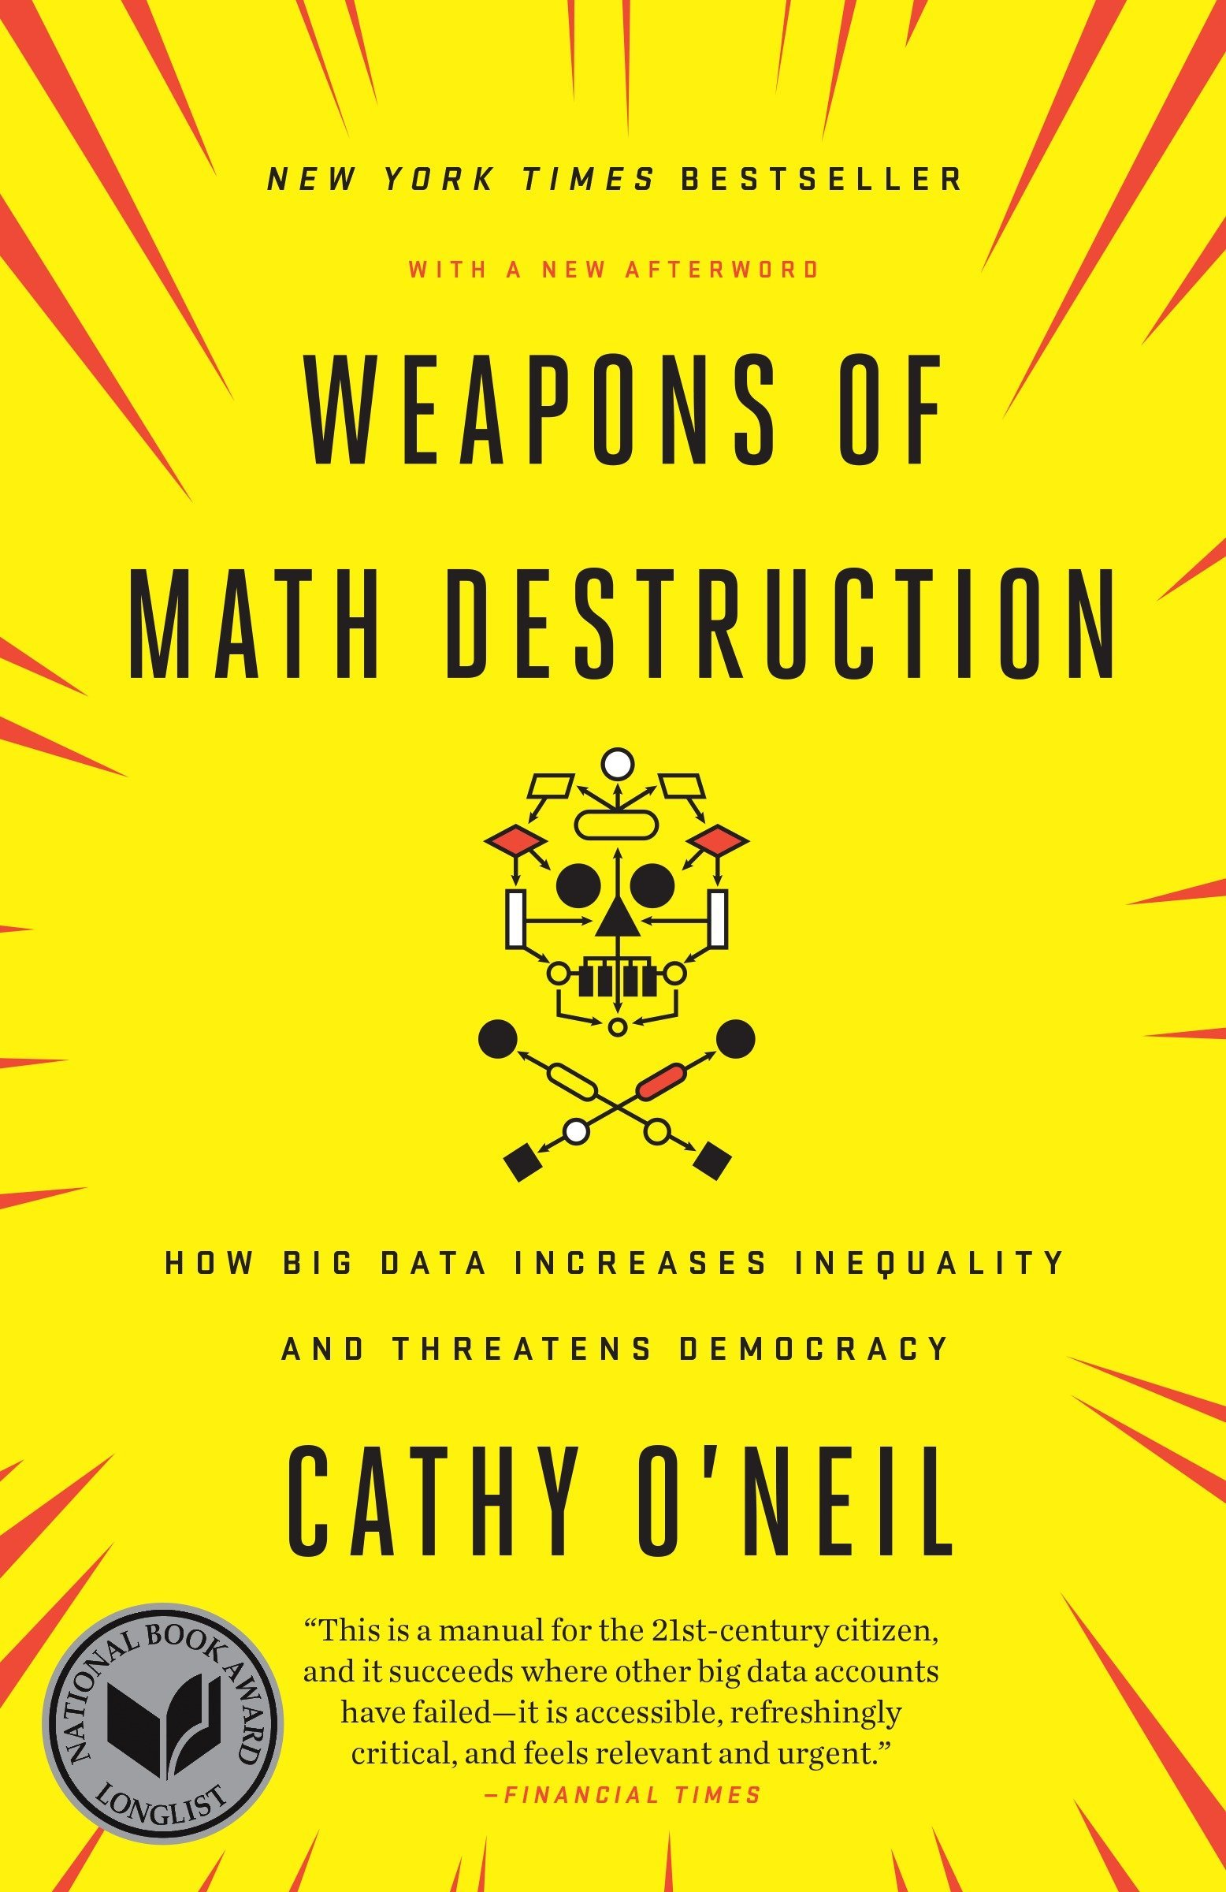
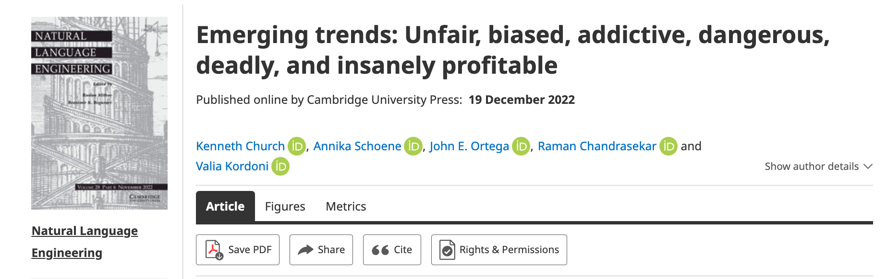
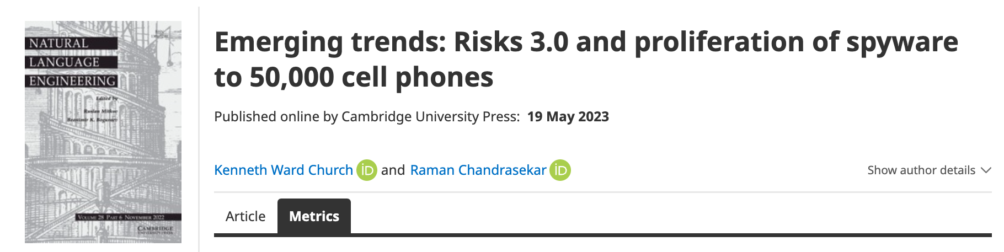
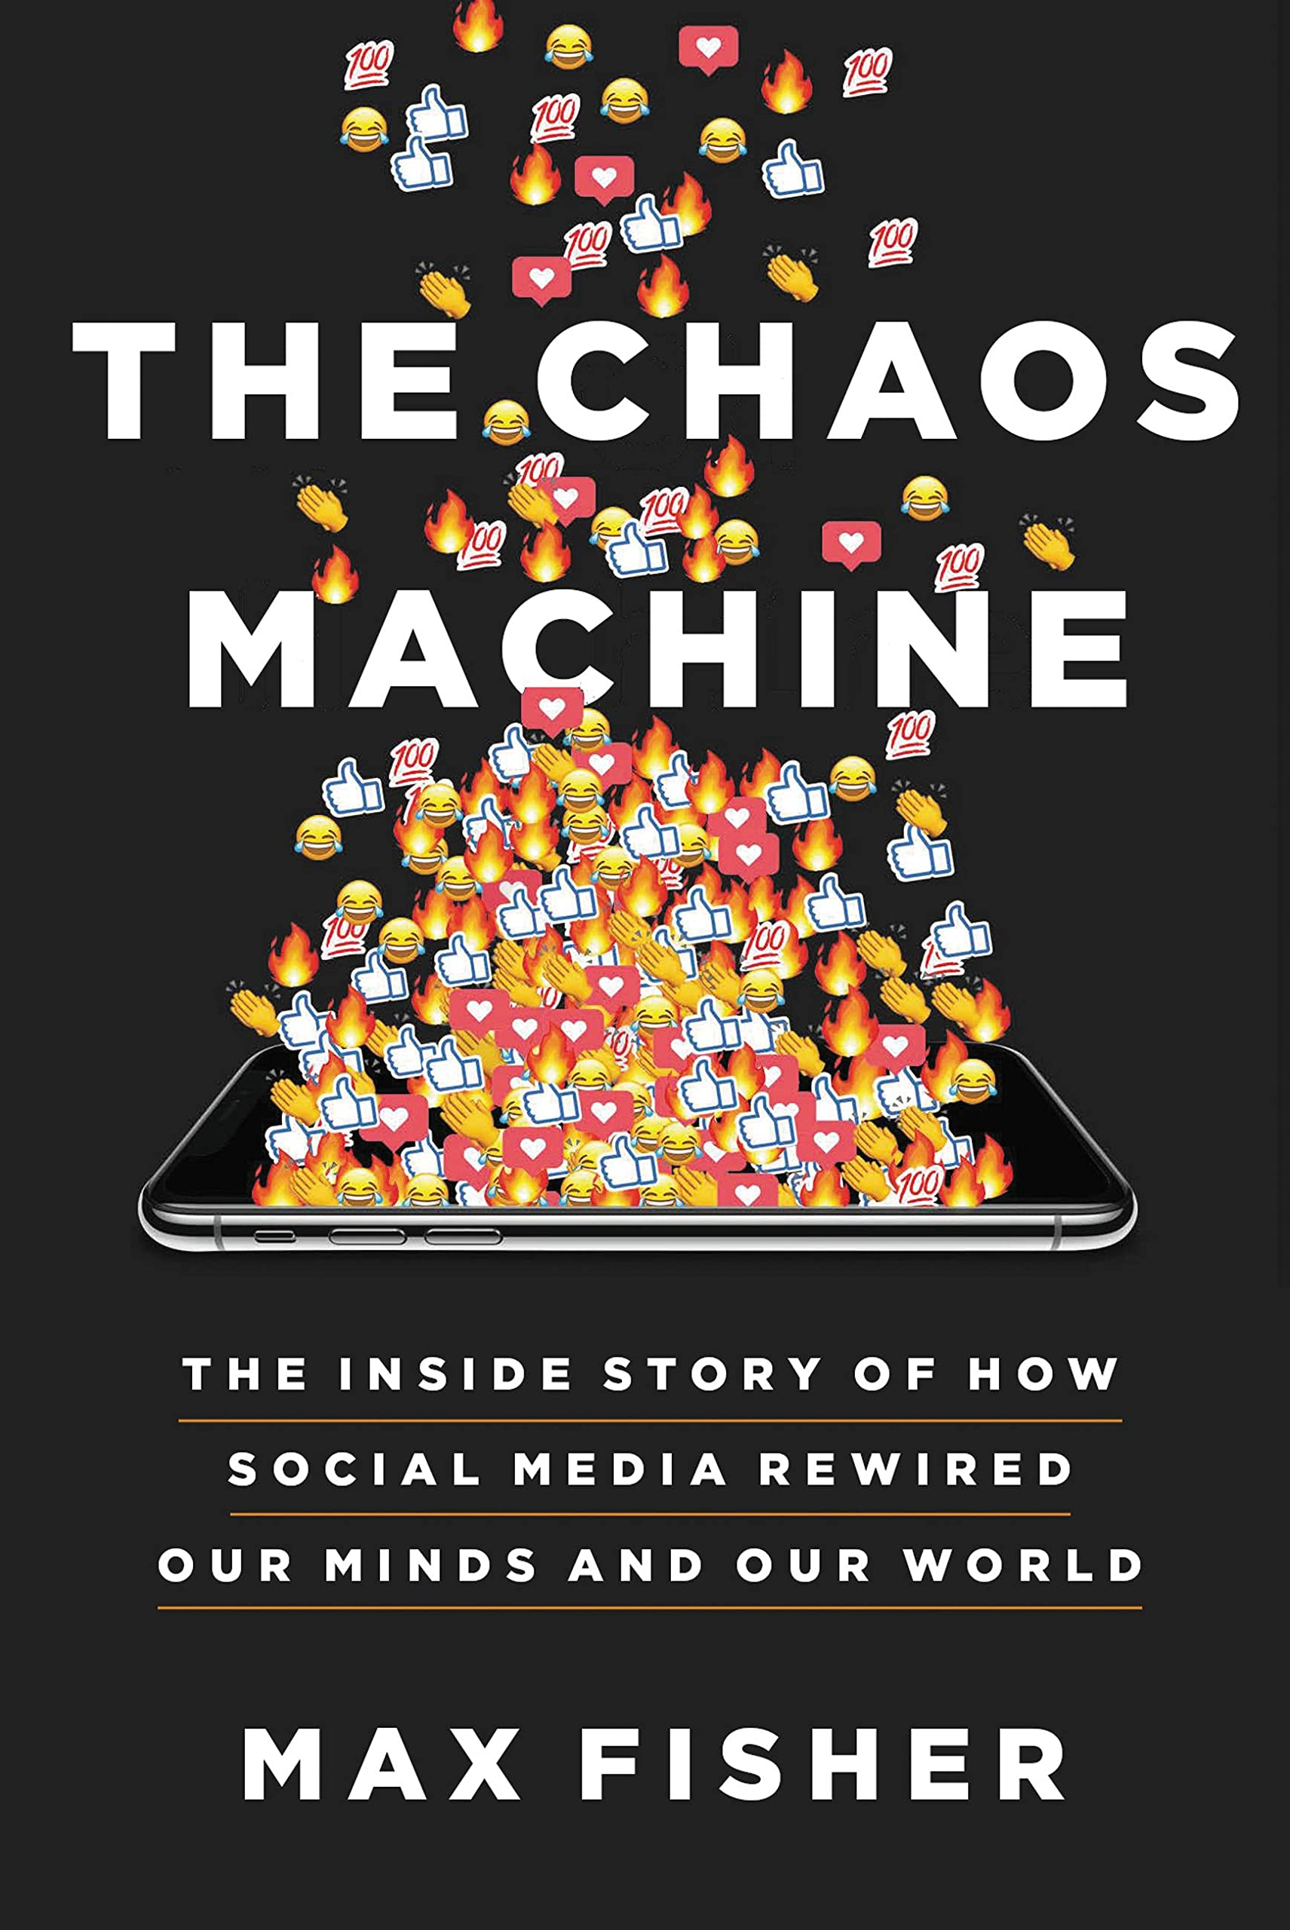

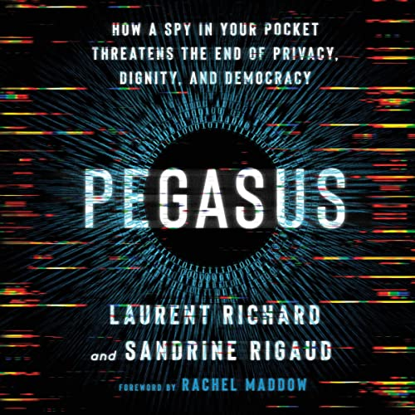
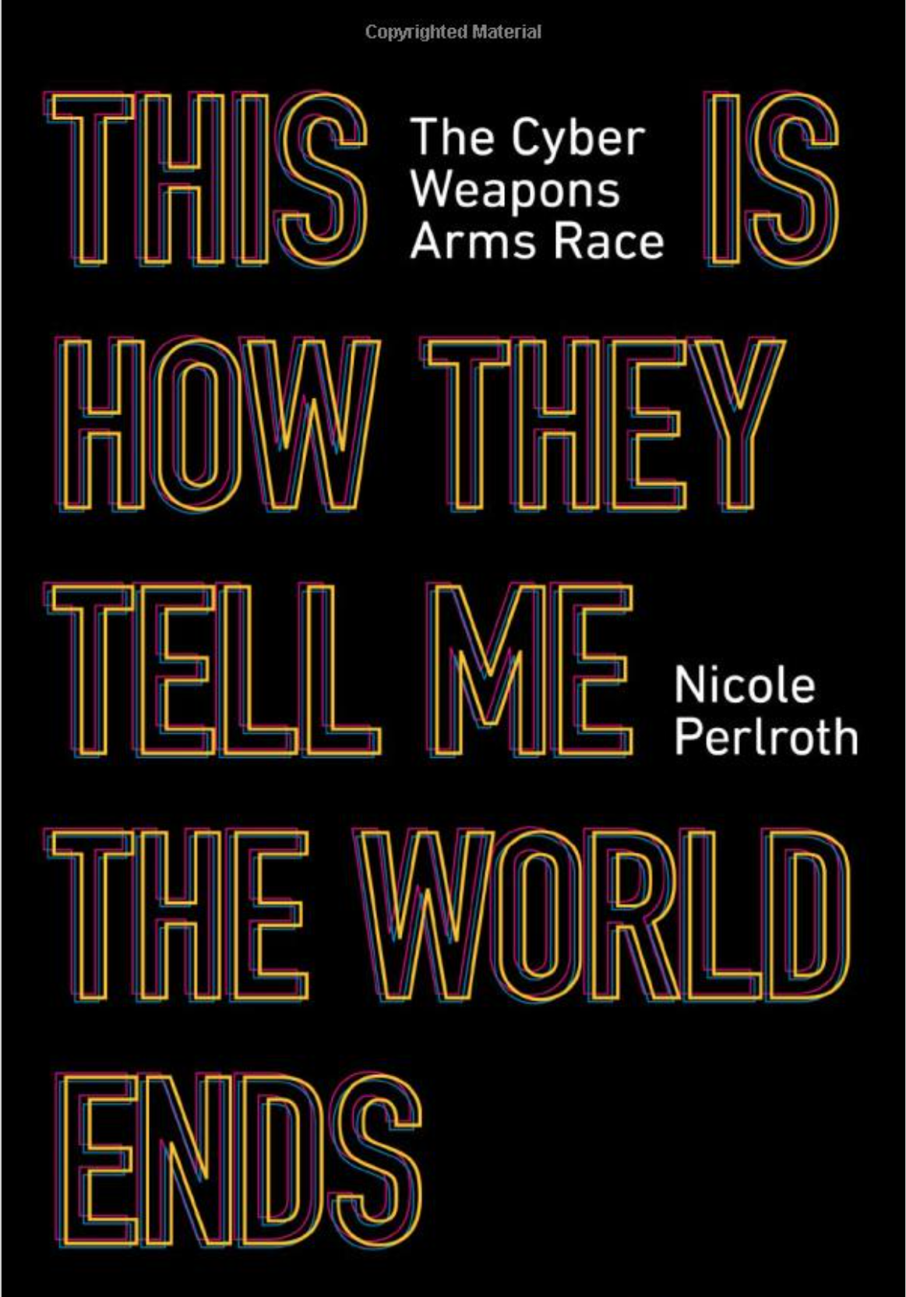
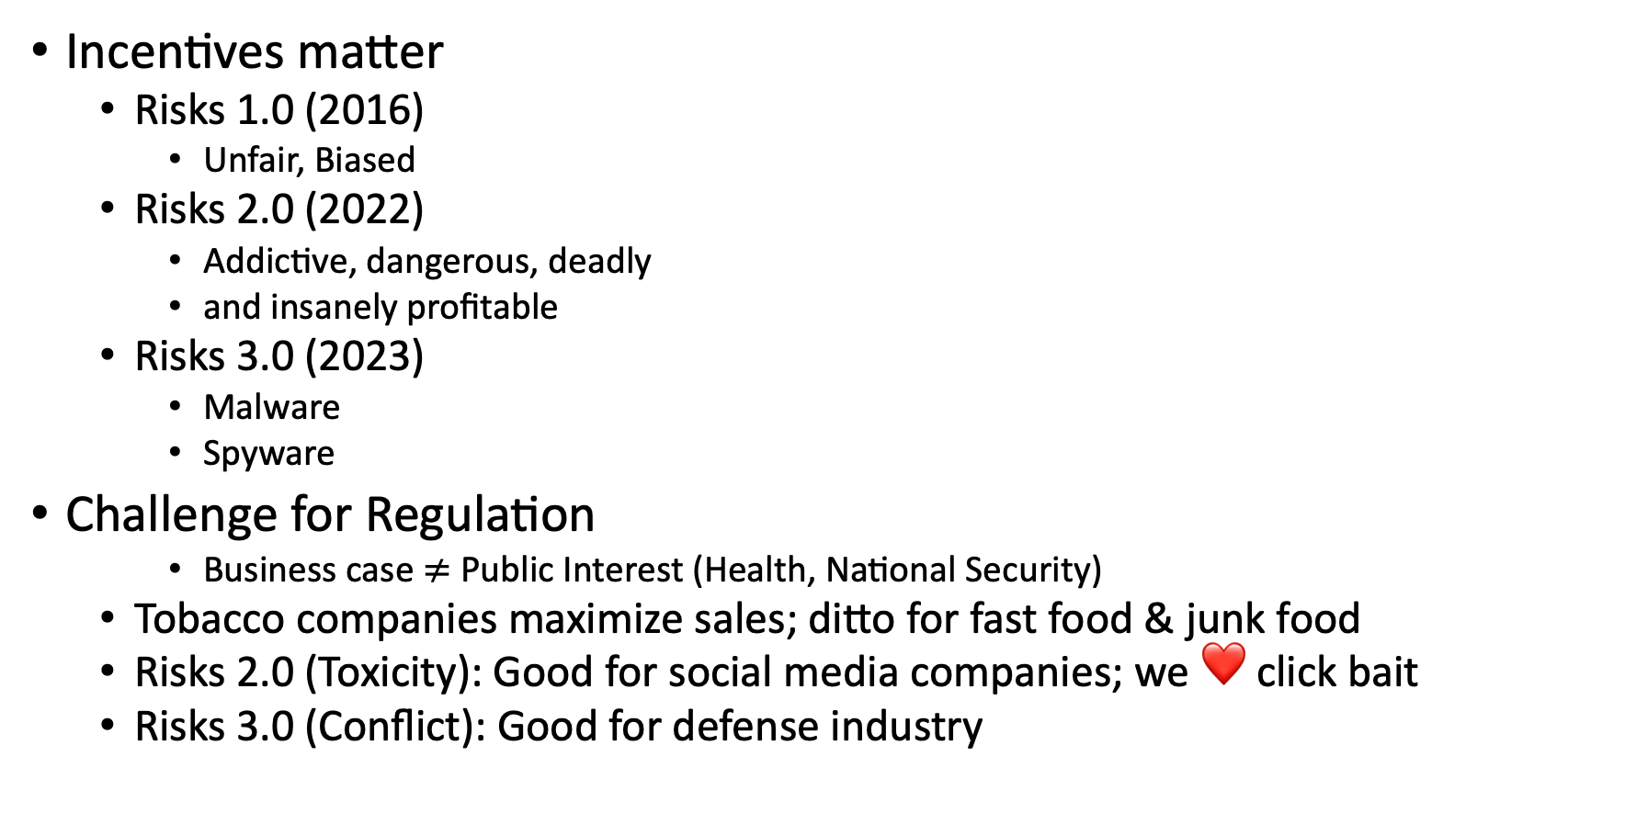
Ugly: Responsible AI
Incentives matter
Risks 1.0 (2016)
Unfair, Biased
Risks 2.0 (2022)
Addictive, dangerous, deadly
and insanely profitable
Risks 3.0 (2023)
Malware
Spyware
Challenge for Regulation
Business case $≠$ Public Interest (Health, National Security)
Tobacco companies maximize sales; ditto for fast food & junk food
Risks 2.0 (Toxicity): Good for social media companies; we ❤️ click bait
Risks 3.0 (Conflict): Good for defense industry

Slide 3
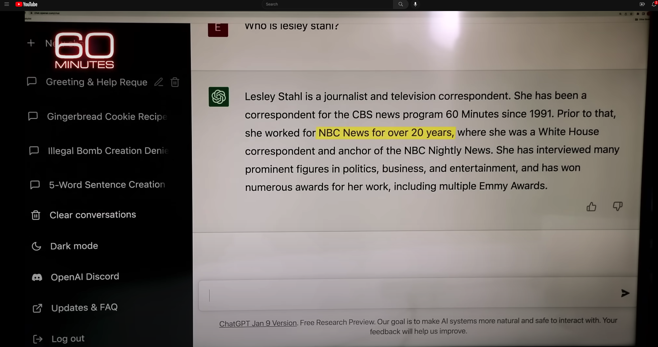

Hallucinations
Prompt
Language models
make up ``alternative facts’’
faster than fact-checking
Dangerous failure mode
People will believe these ``alternative facts’’
More fluent
than trustworthy
Smooth talking-machines
Hallucination
ChatGPT Hallucinates on CBS ``60 Minutes’’ https://www.youtube.com/watch?v=1wzPr4cUoMQ&t=463s
https://github.com/kwchurch/ACL2022_deepnets_tutorial
3

Slide 4

Hypothesis: NLP History → Strengths & Weaknesses
Deep Nets are
more fluent
than trustworthy
Pendulum Swung Too Far (2011)
Empiricism (1950s)
Rationalism (1970s)
Empiricism (1990s)
Deep Nets (2010s)
Truth
Fluency
Fluency
Fluency

Slide 5
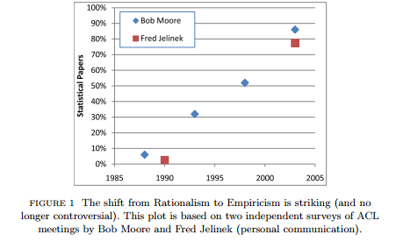
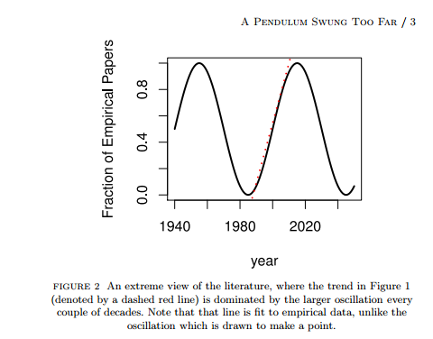
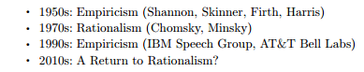
History: Pendulum Swung Too Far
⚠️ ⚠️ ⚠️ Warning ⚠️ ⚠️ ⚠️
Unrealistic Expectations → Winter
Mechanism
⚠️ ⚠️ ⚠️ Warning ⚠️ ⚠️ ⚠️
Unrealistic Expectations → Winter

Slide 6
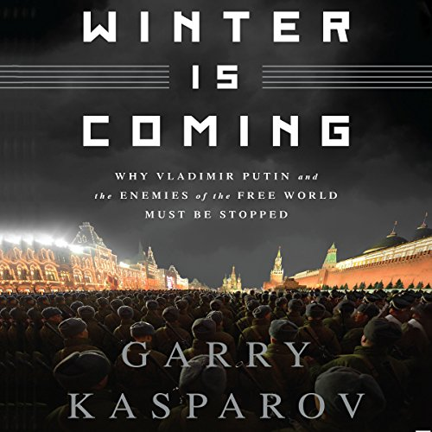
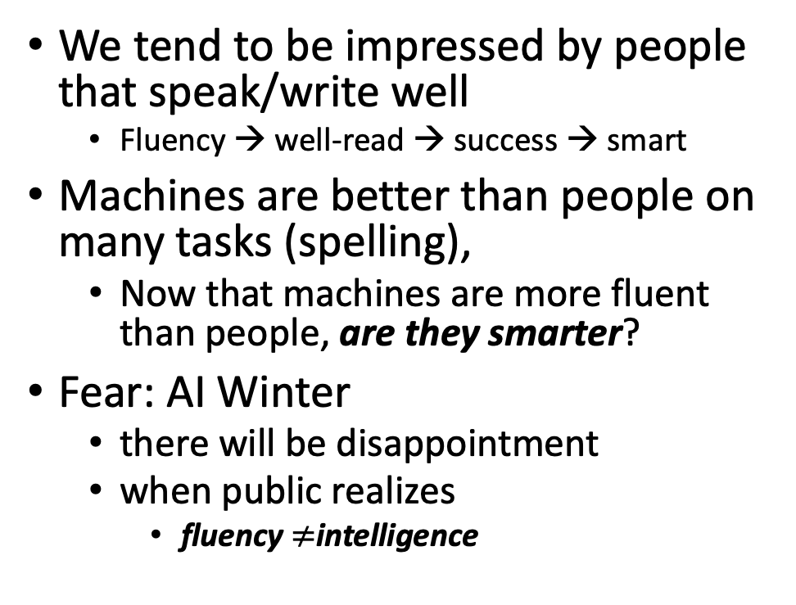
Winter is Coming
We tend to be impressed by people that speak/write well
Fluency → well-read → success → smart
Machines are better than people on many tasks (spelling),
Now that machines are more fluent than people, are they smarter?
Fear: AI Winter
there will be disappointment
when public realizes
fluency $≠$intelligence
Pendulum Swung Too Far
There have been many AI Winters
Often, after ``irrational exuberance’’
(like current excitement with nets)

Slide 7
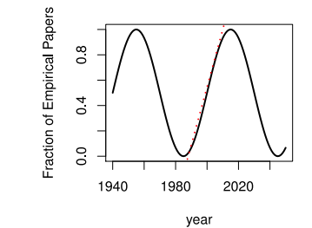
Large Language Models (LLMs) Strengths (1950s/1990s); Weaknesses (1970s)
Easy
Easy
Strengths (fluency)
1950s/1990s: Empiricism
Shannon, Skinner, Firth, Harris
You shall know a word by the company it keeps (Firth, 1957)
Collocations (Easy for Machines)
Distributional Hypothesis (Zellig Harris):
PMI, Word2Vec, BERT
No ``hard’’ stuff
Weaknesses (Hallucinations)
1970s: Rationalism (``Hard’’ Stuff)
Chomsky, Minsky
Truth: logic, possible worlds
Meaning
Purpose (Gricean Maxims)
Common Sense
Hard

